Slide 2
CYA (Covering Your Assets) with security and threat detection in Azure
BRK2421
Mike Nelson – Field Technologist @ Rubrik
Leah Schoeb – Master Technologist @ Rubrik
Ken Hui – Solutions Technologist @ Rubrik

Slide 3

Notes:
Curious questions for the audience –
How many running production IaaS workloads in Azure?
How many of those have security processes in place for VM deployments?
Has anyone ever been attacked (that they know of)? Brute Force? DDoS? Ransomware?
How many have used Security Center?

Slide 4

Notes:
Traditional thinking of being able to apply security measures in a public or even hybrid cloud scenario just doesn’t fit any longer. You cannot “touch” your hardware any longer, as well as you cannot just ignore or make compliance and governance of IaaS resources in the public cloud an after-thought. It is critical that you embrace, learn and implement the security mechanisms and solutions provided by the public cloud providers such as Azure.

Slide 5

Is this your cloud Infrastructure security?

Slide 6
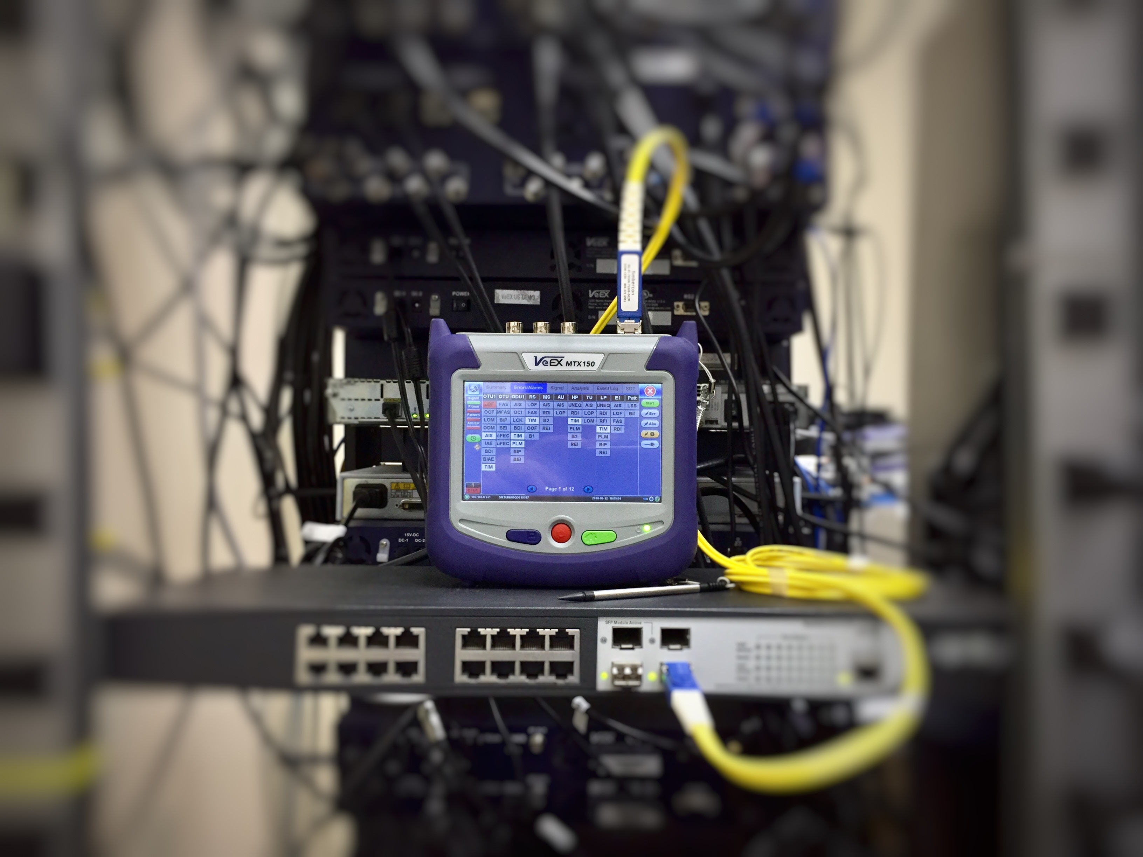
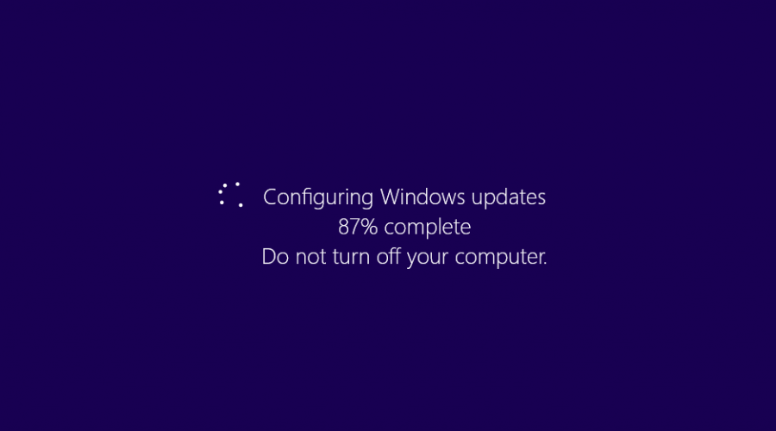

The Easy Hits
Inbound ports open
Missing OS updates
Weak user passwords

Slide 7

Interesting Security Info
>2 million breach attempts per day
Highest percentage of “encounters”:
Botnets
Crypto Lockers
Phishing
Ransomware
Over 1k brute force attacks every second
Gamaru Botnet (aka Andromeda) tops all disruptions since Conficker with 1800+ CaCC’s, 464 distinct botnets, & 80+ malware variant families
Ransomware-as-a-Service now available
Sources: SIR Volume 23, Cyberdefense Research Report 2017

Slide 8
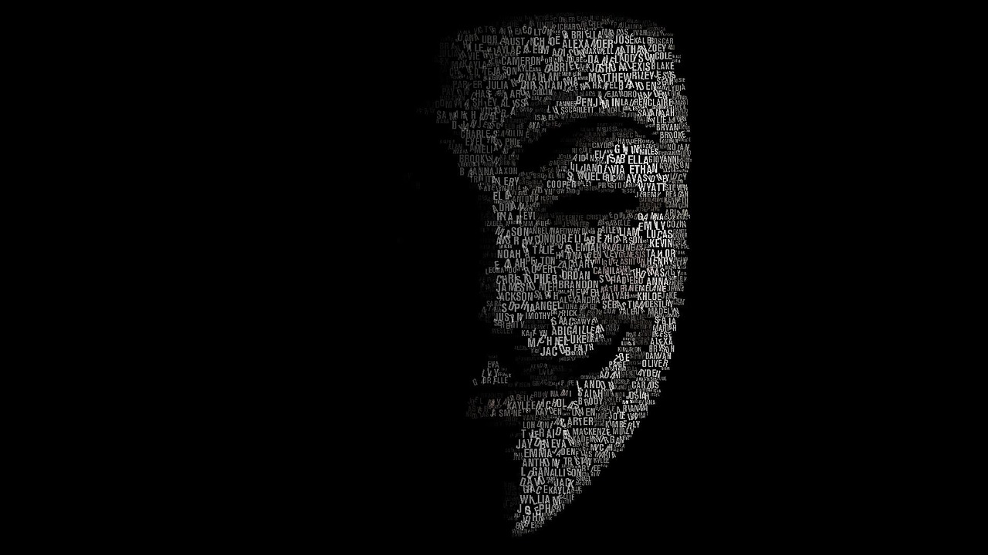
Brute Force Attacks
100k attacks a month/avg
RDP & SSH most common
Ports left open
Accidental or ‘on purpose’
Easy to do
Brute Forcing for Dummies
Lock it down
Implement JiT access

Slide 9






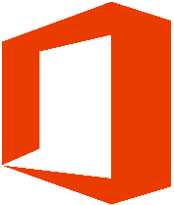




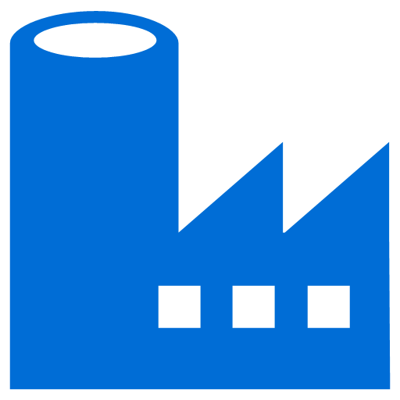
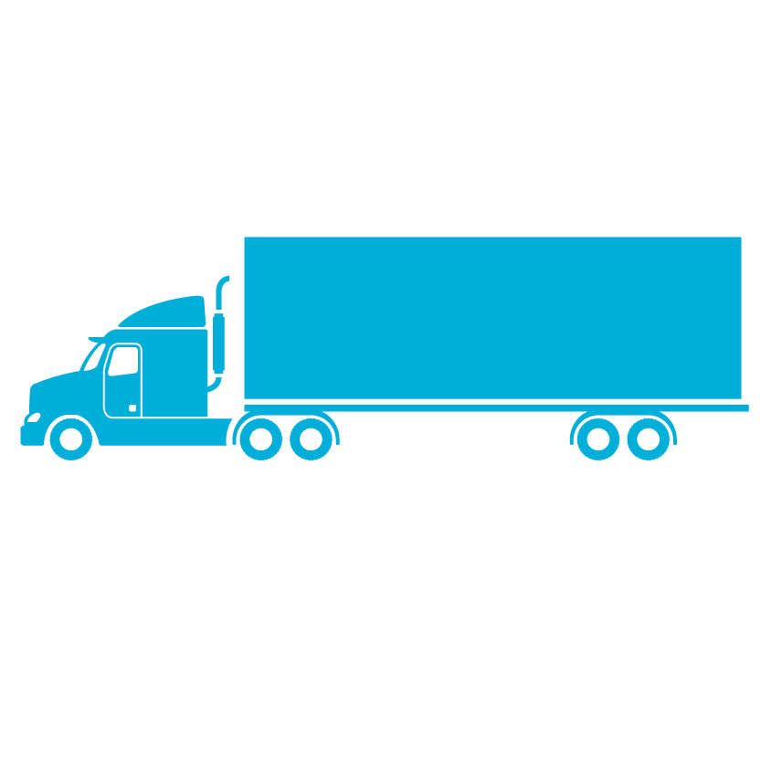
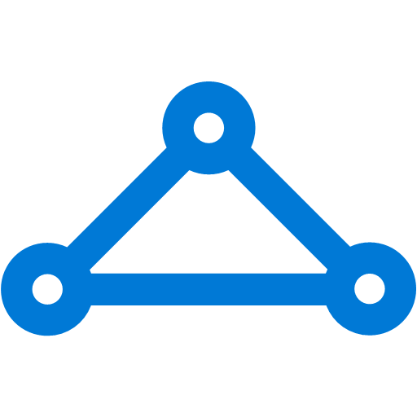
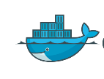



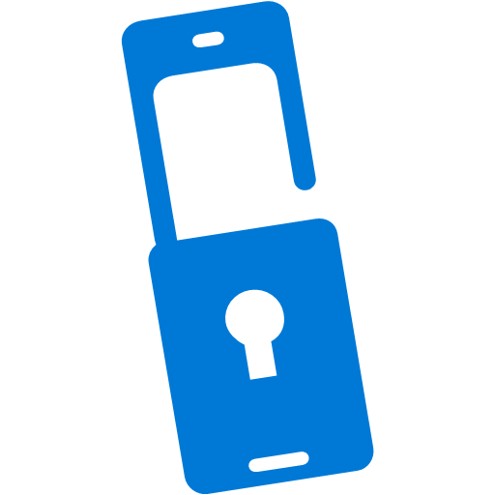



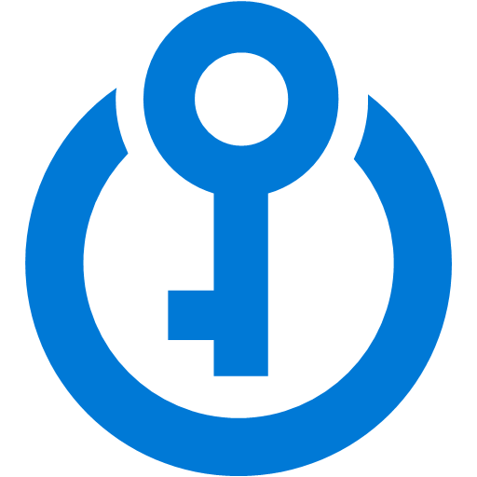
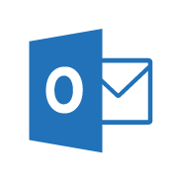

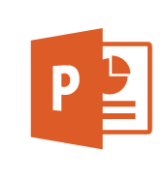
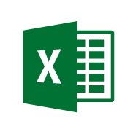

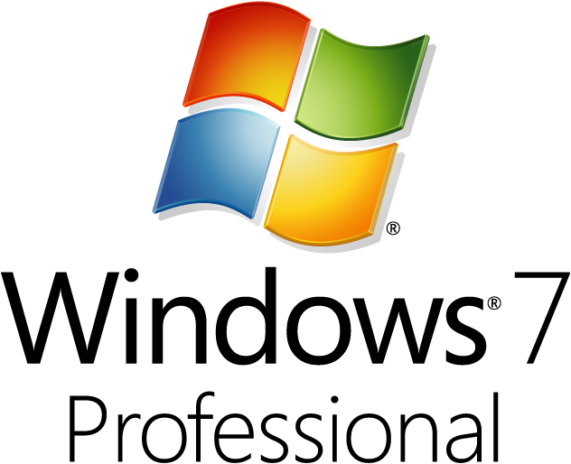
Cybersecurity Reference Architecture
Software as a Service
Office 365
80% + of employees admit using non-approved SaaS apps for work (Stratecast, December 2013)
ASM
Vulnerability Management
Security Operations Center (SOC)
Incident
Response
Security Development Lifecycle (SDL)
Investigation
and Recovery
Lockbox
Logs & Analytics
Internet of Things
Active Threat Detection
Unmanaged & Mobile Clients
Identity & Access
Information
Protection
Managed Security Provider
UEBA
ATA
Hunting Teams
Enterprise Threat Detection
Azure Active Directory
Analytics
OMS
Cloud App Security
SIEM
PADS
Conditional Access
Intune MDM/MAM
Azure AD
Identity Protection
Office 365 DLP
Extranet
SIEM Integration
On Premises Datacenter(s)
Edge DLP
Express
Route
NGFW
Colocation
Security Appliances
Microsoft Azure
Azure AD PIM
Azure
Information Protection (AIP)
Classify
Label
Protect
Report
SSL Proxy
Office 365 ATP
Email Gateway
Anti-malware
IPS
Multi-Factor Authentication
Azure Security Center
Threat Protection
Threat Detection
VPN
Hello for Business
Azure Key Vault
Classification Labels
Enterprise Servers
Hold Your Own Key (HYOK)
Shielded VMs
Windows Server 2016 Security
Shielded VMs, Device Guard, Credential Guard, Just Enough Admin, Hyper-V Containers, Nano server, …
Azure App Gateway
MIM PAM
VMs
VMs
Azure Antimalware
ATA
Domain Controllers
Network Security Groups
Active
Directory
ESAE Admin Forest
VPN
Structured Data & 3rd party Apps
Privileged Access Workstations (PAWs)
Endpoint DLP
$
Managed Clients
SQL Encryption & Firewall
Certification Authority (PKI)
Windows Info Protection
Legacy Windows
Windows 10
Device Health Attestation
Remote Credential Guard
Sensitive
Workloads
Windows 10 Security
Secure Boot
Device Guard
Application Guard
Credential Guard
Windows Hello
Disk & Storage Encryption
WEF
Mac
OS
EDR - Windows Defender ATP
IoT
DDoS attack mitigation
Nearly all customer breaches that Microsoft’s Incident Response team investigates involve credential theft
63% of confirmed data breaches involve weak, default, or stolen passwords (Verizon 2016 DBR)
EPP - Windows Defender
System Center Configuration Manager + Intune
Backup and Site Recovery
Last updated March 2017 – latest at http://aka.ms/MCRA

Slide 10
Responsibility Zones
On Premises
Infrastructure
(as a Service)
Platform
(as a Service)
Software
(as a Service)
You manage
Applications
Applications
Applications
Applications
Data
You manage
Data
Data
Data
Runtime
Runtime
Runtime
Runtime
Managed by Microsoft
You manage
Middleware
Middleware
Middleware
Managed by Microsoft
Middleware
O/S
O/S
O/S
O/S
Managed by Microsoft
Virtualization
Virtualization
Virtualization
Virtualization
Servers
Servers
Servers
Servers
Storage
Storage
Storage
Storage
Networking
Networking
Networking
Networking
Notes:
Slide Objectives:
Explain the differences and relationship between IaaS, PaaS, and SaaS in more detail.
Speaking Points:
Here’s another way to look at the cloud services taxonomy and how this taxonomy maps to the components in an IT infrastructure.
Packaged Software
With packaged software a customer would be responsible for managing the entire stack – ranging from the network connectivity to the applications.
IaaS
With Infrastructure as a Service, the lower levels of the stack are managed by a vendor. Some of these components can be provided by traditional hosters – in fact most of them have moved to having a virtualized offering.
Very few actually provide an OS
The customer is still responsible for managing the OS through the Applications.
For the developer, an obvious benefit with IaaS is that it frees the developer from many concerns when provisioning physical or virtual machines.
This was one of the earliest and primary use cases for Amazon Web Services Elastic Cloud Compute (EC2).
Developers were able to readily provision virtual machines (AMIs) on EC2, develop and test solutions and, often, run the results ‘in production’.
The only requirement was a credit card to pay for the services.
PaaS
With Platform as a Service, everything from the network connectivity through the runtime is provided and managed by the platform vendor.
The Windows Azure best fits in this category today.
In fact because we don’t provide access to the underlying virtualization or operating system today, we’re often referred to as not providing IaaS.
PaaS offerings further reduce the developer burden by additionally supporting the platform runtime and related application services.
With PaaS, the developer can, almost immediately, begin creating the business logic for an application.
Potentially, the increases in productivity are considerable and, because the hardware and operational aspects of the cloud platform are also managed by the cloud platform provider, applications can quickly be taken from an idea to reality very quickly.
SaaS
Finally, with SaaS, a vendor provides the application and abstracts you from all of the underlying components.

Slide 11
Spectrum of control and trust
Maximum
CONTROL
Outsourced TRUST
On-Prem
IaaS
PaaS
SaaS
Isolated VMs
Trusted Execution Environment
SQL Transparent Encryption, Azure Services in a VNet
Customer Lockbox
Azure Active Directory, Azure Key Vault
Underlying trusted platform
Azure Control Plane, Just in Time Access, Monitoring, Audit and Reporting
Where you land drives service model selection
Notes:
Every developer has a trade-off between control and trust models. Imagine it as a spectrum, and I will illustrate how to choose between multiple deployment models.
The traditional IaaS-based deployment model is to build it using virtual machines. This obviously offers the most control to the developers and security teams.
When it comes to microservices and building cloud-native apps, we have PaaS. Though developer and security teams outsource a little bit of trust, productivity is greatly increased.
Finally, there are SaaS deployments, such as Office 365 and Dynamics 365.
The point is that all three models are built upon Azure’s control plane and a comprehensive identity and encryption key management system.
What that means for you is that you now have more choices for developers, IT operations, and security teams along the control-trust continuum.

Slide 12
Logical layered isolation
Notes:
Isolation is key to protecting Azure deployments. There are many elements that create a layered approach to securing your data and applications in Azure. As this picture shows Internet access, we will look at how your deployment can be secured against such exposure. What is worth noting is the sophisticated Distributed Denial of Service protection based on machine learning and Microsoft’s global view of real-time security threats.

Slide 13


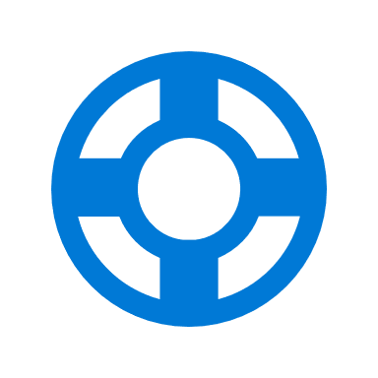

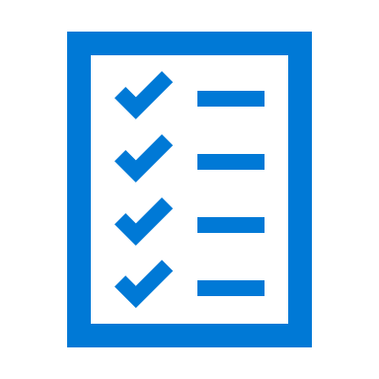
IaaS Security Points of Interest (POI)
Identity
Azure Active Directory
Hybrid AD
Local users
MFA
Connectivity
Internet
Tunneling
Source IP
S2S VPN
ExpressRoute
Data Protection and Privacy
Storage Encryption
Disk encryption
VM encryption
RBAC
JiT access
Threat Defense
Security hardening
Advanced Threat Protection
Pen testing
Update management
Monitoring & alerting
Analytics
Compliance
Compliant services
Auditing
Policies

Slide 14

Anatomy of real attack in Azure
PORT SCANNING ACTIVITY DETECTED
BRUTE FORCE ACTIVITY DETECTED
SUSPICIOUS PROCESS EXECUTED ON VM
DNS DATA EXFILTRATION ACTIVITY DETECTED
KILL CHAIN INCIDENT GENERATED
Reconnaissance
Weaponization
Data Breach
Installation
Command & Control
Incident
response
Attacker port scans to look for potential victims
Attacker launches a brute force attack on targets and breaches exposed interfaces
Attacker installs custom malware on the VM
Malware contacts its command and control and sends the data over the DNS protocol
The VM owner receives the information and shuts down the VM
Attacker compiles a list of targets with open interfaces
Attacker injects blind SQL commands into the Virtual Machine (VM)
Malware activates and scans the VM for confidential information and data
Security incident is generated, information is compiled and sent to the VM owner

Slide 15
Alternatives to IaaS to consider
Containers
PaaS
SaaS
Minimal OS
Serverless
Not just for DevOps anymore
Very secure and completely controllable security layers for standalone containers
Container Services are more PaaS managed
Security layers controlled by provider
Compliance and governance are more static than dynamic
Security layers controlled by provider
“Buy it and forget it”
Security hardened OS
Limited applications and drivers
Linux and Windows flavors
Everything as a service, PaaS, SaaS, xaaS
It’s really not “Serverless”

Slide 16
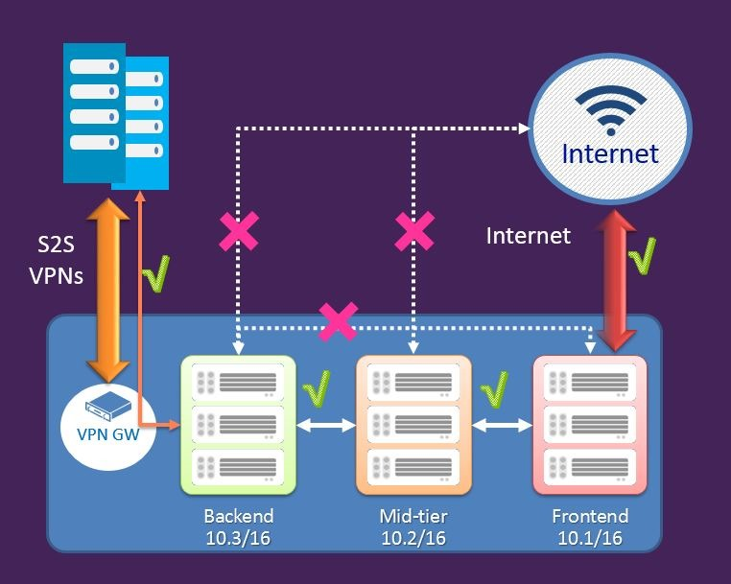
Network Security Groups (NSG)
Define access control rules for inbound/outbound traffic to a VM or group of VMs in a subnet
NSG rules can be changed at any time and apply to all instances
NSG can be associated with:
A single VM in a VNet
A subnet in a VNet
A VM and a Subnet together for added security
Rules are processed in order of priority
Rules are based on 5-tuple (source/dest IP/port, protocol)
Notes:
You can now create Network Security groups to define access control rules for inbound and outbound traffic to a Virtual machine or a group of virtual machines in a subnet. The security groups and the rules can be managed and updated independent of the life cycle of the VM.
http://azure.microsoft.com/blog/2014/10/29/networking-enterprise/
https://anderseideblog.wordpress.com/2014/10/30/network-security-groups-in-azure/
https://azure.microsoft.com/en-in/documentation/articles/virtual-networks-nsg/
added note that rules are based on the 5-tuple (source/dest IP/port, protocol)

Slide 17
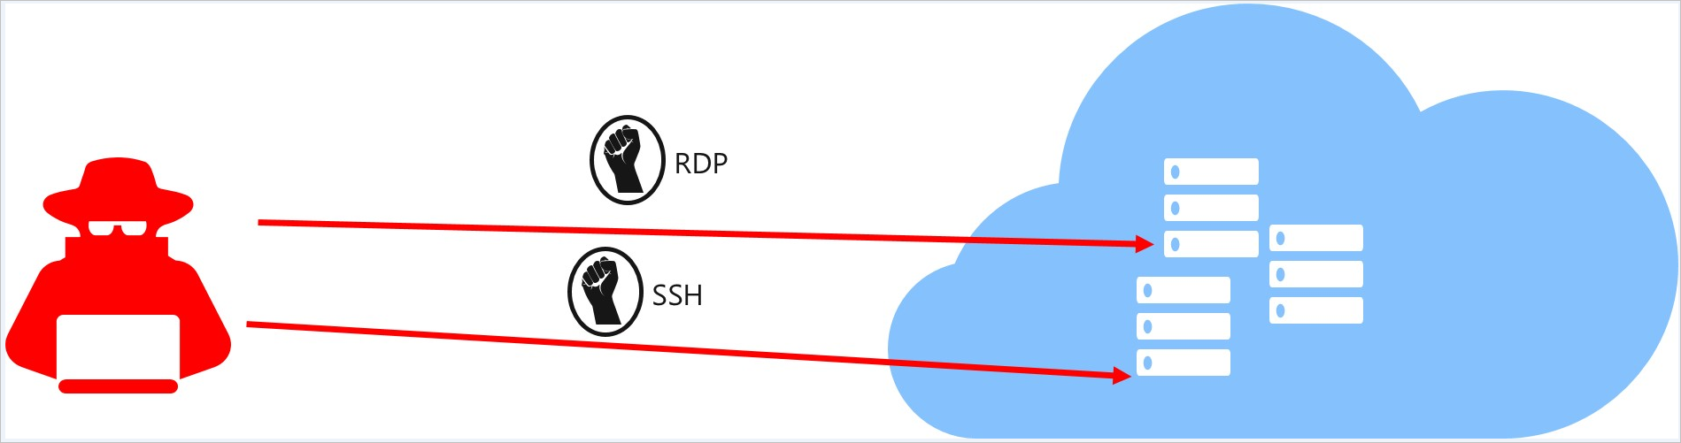
VM Just-in-Time Access (JiT)
JiT policies allow for inbound port control using RBAC and time limits. RDP and SSH are examples of the most actively used ports.
JiT will automagically configure NSG’s to open ports for access to specific accounts, and will return the NSG to original state after the variable timer has elapsed.

Slide 18
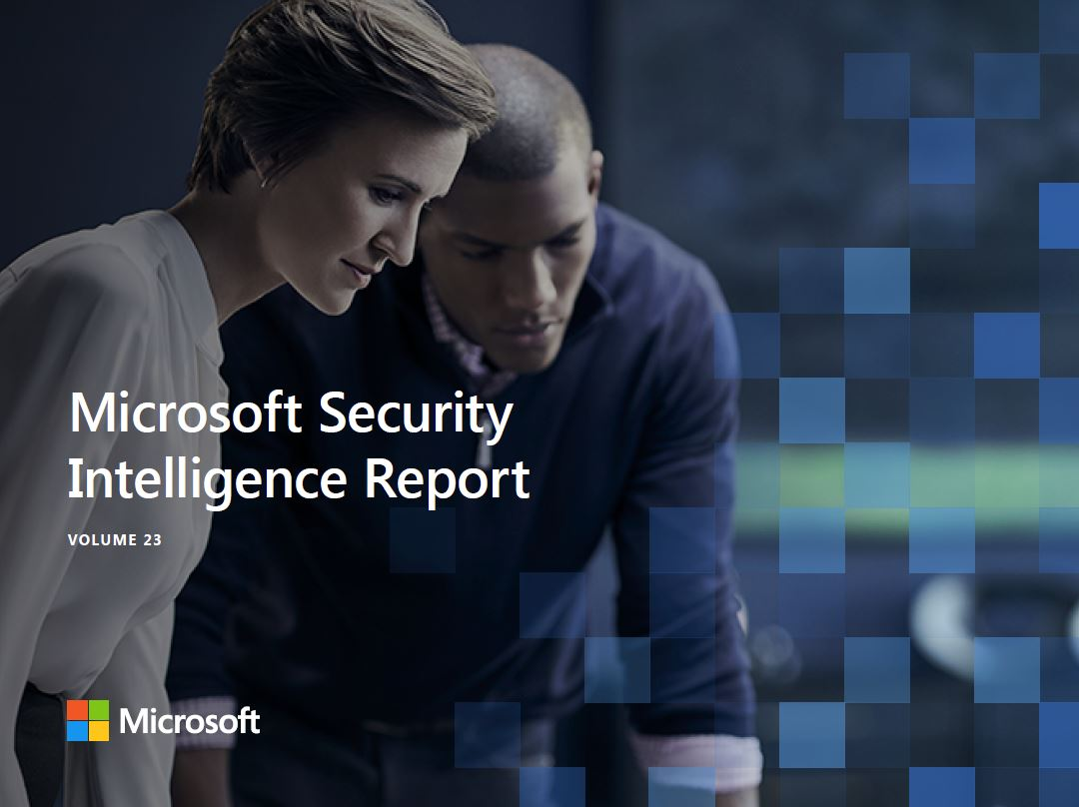
Notes:
SIR is available for download

Slide 19
Previews & GA’s
Azure Security Center
Azure Secure Score
Confidential Compute
Azure Firewall
Microsoft Threat Protection (ATP)

Slide 20
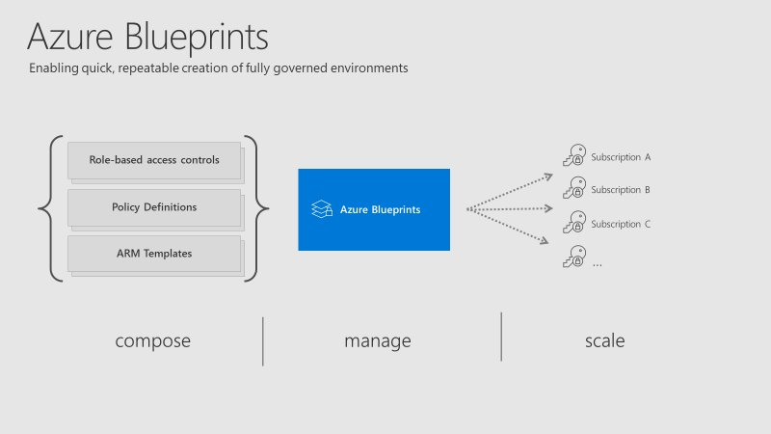
Notes:
Define user access, policies, and resources
Rapidly create new environments with pre-defined requirements
Bottom line = more control

Slide 21

Key Takeaways
Secure
Secure the VMs on creation & through lifecycle
Encrypt
Encrypt VM disks, storage, and data
Control
Control network traffic flows, rules, firewalls – limit exposure
Monitor
Monitor everything & use Machine Learning solutions like Polaris Radar
Collect data
Collect security data and archive based on retention/compliance

Slide 22
Demo VM Security & Security Center

Slide 23
Data Protection, Detection, and Mitigation
Rubrik Cloud Data Management

Slide 24
Simplify Data Protection
Infrastructure Security and Recoverability
Immutable Data Protection
Self Protecting Infrastructure
End-to-End Encryption
Fast Recovery in Minutes
Highly Optimized Software
Scale-Out Brik Cluster
Public
3rd Party Storage
Next Generation Protection
Notes:
Considerations for prevention, detection, and mitigation
On prem and cloud protection
Builds a global architecture
immutable backup and appliance isolation for added data protection

Slide 25




Your Data Center Today
Production Servers
Backup Proxy
SAN
Backup Server
Disk-Based Backup
Search Server
Tape Archive
Offsite Tape Vault
25
Notes:
Take out the legacy systems
Think about what the hyperconvergence movement is doing to the modern data center
You can’t maintain and deploy all of the legacy infrastructure when you are moving to hyperconvergence.

Slide 26

Rubrik’s Vision Simplifies Your Data Center
Production Servers
Scale Out
Rubrik
SAN
Scale Out
Private
Next Generation Protection
Replication + Long-Term
Retention + Search
Notes:
Theme: The vision of Rubrik reaches far beyond simple data protection
Layers of defense - Prevention (agents/firewall), detection, and mitigation
Focus was traditionally on prevention, but that is not good enough, detection and mediation is needed
Add context - why does this model work vs previous models
Mutations are impossible to keep up with; have to leverage ML to keep up with dynamic nature of ransomware
There is a macro-level trend in infosec around making good security and good behavior easier (vs. blaming the end-user for being stupid). This matches nicely with our messaging around simplicity, automation, UX, etc.
immutable backup and appliance isolation
Take out the legacy systems
Think about what the hyperconvergence movement is doing to the modern data center
You can’t maintain and deploy all of the legacy infrastructure when you are moving to hyperconvergence.

Slide 27
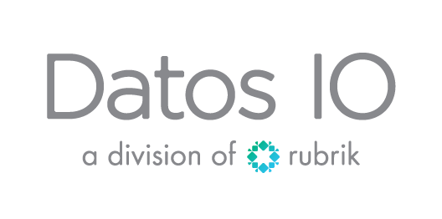
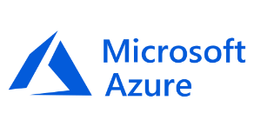
Datos IO Microsoft Azure Platform for NoSQL
Azure Blob Storage for NoSQL backups!
Added Azure Blob Storage API support
RDIO Architecture for NoSQL Backups:
Application Listeners that read from and write to secondary storage such as Azure Blob Storage (ABS)
Datos IO compute nodes that read, de-dupe, and store data back to ABS
SFL (data plane) layer that controls access to secondary storage in both Application Listeners and Datos IO compute nodes

Slide 28
Global Reporting, Data Analytics, Data Protection, and Governance
Polaris SaaS Platform

Slide 29
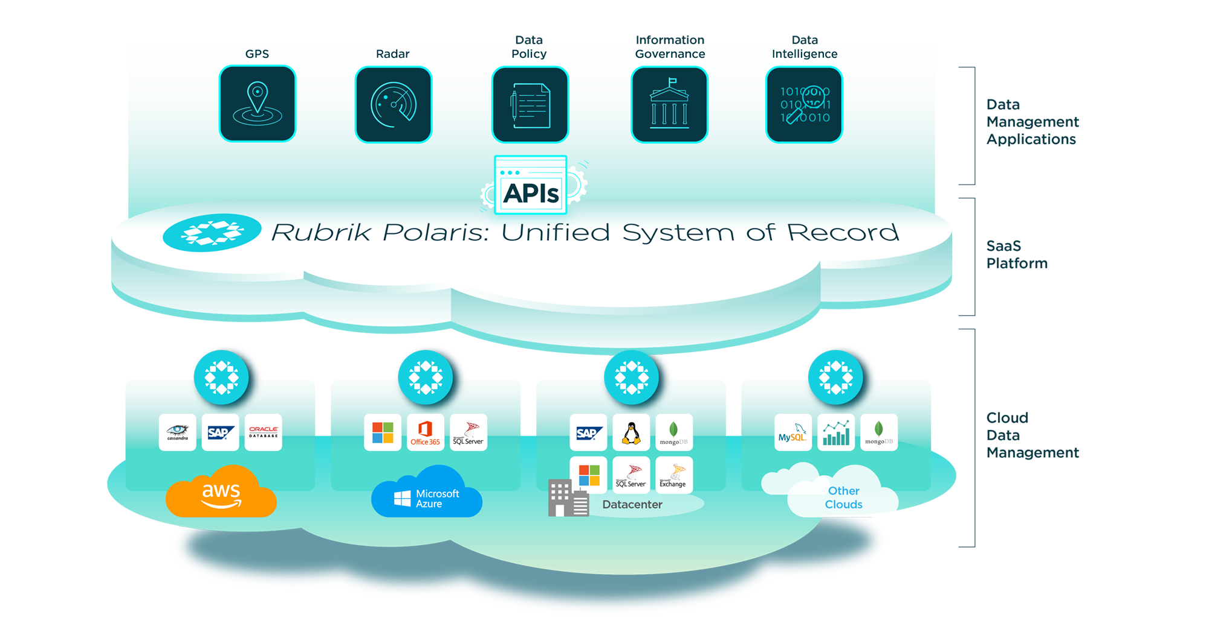
Rubrik Global Detection and Mitigation
Cloud provides global view of the business
A unified system of record brings all BI/Analytics apps and data together on a common platform
Polaris offers a new class of data management apps via open APIs
Apps address data control, policy, information governance, security, data intelligence

Slide 30

Polaris Radar Last Line of Defense

Slide 31


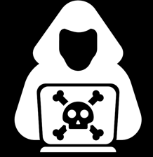


Prevention is Essential, but Attacks Still Happen
Prevention
X
71%
of enterprises were hit by ransomware that successfully bypassed their detection and prevention measures
Source: Barkly Inc. survey
X
Notes:
- Ransomware attacks are growing at an alarming rate of more than 350% annually.
- ESG finding - of their survey
- According to a Barkley survey over 70% of companies have had their security perimeter bypassed by ransomware. This means almost 3 out of 4 of companies have been hit successful by ransomware attacks.
- This may not be new information for you since we see it in the media all the time.
(pull up that latest attack for each presenting) Just in the last 2 weeks alone these attacks.
The reason why we are here is because we don't want to see this happen to you.
what does that mean to you? even if 1% of attacks gets through how much would that cost you on a daily basis?
Wouldn’t you like to minimize that cost?
And the volume of attacks are not decreasing or going away it’s a problem that is getting worse.
Many companies believe the most effective strategy for defending against ransomware is preventing them from ever entering your data center in the first place. Any IT organization with good security hygiene knows that you must protect the perimeter to keep threats out.
In a perfect world, the perimeter would be all you need. In reality, preventing every threat, every time, across every surface area, is an incredibly difficult task.
That’s because malware is getting smarter, and so are the criminals behind them. In fact, 71% of organizations were hit by ransomware after it successfully bypassed their detection and prevention measures, according to endpoint protection provider Barkly.
Attacks happen – even to organizations with great prevention measures.

Slide 32






When an Attack Happens It’s hard to bounce back fast
Prevention
Resiliency
Detection
Identify all strains of ransomware
Analysis
Understand impact of an attack
Recovery
Restore as quickly as possible
Notes:
We talk about prevention as setting up a protective security perimeter but Criminals are working 24/7 to get through security walls
After an attack happens and gets through these walls, IT professionals work hard to detect and recovery as quickly as possible. It can take days to detect, perform the appropriate analysis of effected files and applications and Recover from the last unaffected backup can take days. Recovering from an attack is usually painful and can cause data loss.
Example - One Rubrik customer, a professional services firm, was hit by ransomware before they started using Rubrik.
They had a great security perimeter in place to prevent attacks, but it took them a week to detect the full extent of the infection.
Then they had to list all files from a snapshot 30 days prior to the infection.
Finally, they manually restored the entire NAS share over three days.

Slide 33



Introducing Radar: Recover Faster. Stay Smarter.
Complement your layered approach to security by increasing resiliency against ransomware. Radar accelerates recovery by providing organizations deep intelligence on the impact of an attack.
Recover Faster
Minimize downtime. Restore to the most recent clean state with just a few clicks.
Prevention
Holistic
Ransomware
Response
Increase Intelligence
See how your data has changed to quickly identify what was impacted where.
Leverage machine learning to detect and alert on anomalous behavior.
Resiliency
Notes:
Radar helps you increase your resiliency against ransomware by making it faster and easier to recover from an attack. It does this by providing an intuitive user interface to track how your data has changed over time. You can quickly restore to your latest un-infected backup with minimize downtime. It also increases its intelligence over time by using machine learning to actively monitor and generate alerts for anomalies, like ransomware.
To accelerate the discovery of an attack, Radar provides insight into how your data changed at the time of the event.
So What does Radar mean for you and IT?
It accelerates recovery in the event of an attack from days to hours.
think about how much time and money
Why does Radar matter for “defense in depth” ?
It complements your layered approach to security by providing an additional dimension of data intelligence. Detection and Mitigation
We use machine learning algorithms, so we can continually refine our inteligence over time and stay ahead of new threats.
How will Radar help infosec teams to stay aware in the future?
Polaris will offer open APIs so you can centralize monitoring and reporting.
This will make it easy to integrate Radar’s full functionality into your existing SIEM tools.
Radar helps you increase your resiliency against ransomware by making it faster and easier to recover from an attack. Radar helps you recover faster by providing a simple, intuitive user interface to track how your data has changed over time. With just a few clicks, you can quickly restore to your most recent clean state to minimize downtime. It also increases intelligence by using machine learning to actively monitor and generate alerts for anomalous behavior, like ransomware. To accelerate the discovery of an attack’s impact, Radar provides insight into how your data changed at the time of the event.

Slide 34

Radar: Detect, Analyze, and Recover Easier and Faster
DETECT ANOMALIES
ANALYZE THREAT IMPACT
ACCELERATE RECOVERY
Leverage greater insights on suspicious activity to accelerate detection.
Spend less time discovering which applications and files were impacted.
Minimize downtime by simplifying manual processes into just a few clicks.
Notes:
Radar is broken down into 3 main tasks to create a multi-layered approach of control, monitoring and visibility to defend against cyber-attacks. This includes
Early Detection – Radar adds an additional dimension of data intelligence and alerting on unusual behavior by leveraging machine learning to provide you deeper insights on how your data behaves and evolves over time.
By doing this, we can augment the perimeter built by your security tools and alert you on anomalous behavior as your last line of defense.
Analysis - Radar helps you discover the full scope of the damage. You no longer have to compare snapshots manually looking for the last unaffected backup copy and
sifting through millions of files to see what was infected and what wasn’t. Radar does the analysis for you and presents it to you in an intuitive UI.
Recovery – To accelerate recovery Radar leverages Rubrik's renound Cloud Data Management at the instance level for Instant Recovery.

Slide 35
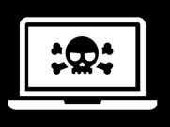

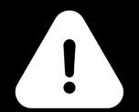
Use Radar to Recover Quickly From Any Security Incident
Ransomware
Insider Threat
Event Monitoring
Recover faster from cyber attacks with deeper insights on on how malware impacted your entire environment.
Identify and restore in the event employees, contractors, or business associates modify or delete sensitive information.
Monitor 24/7 for unexpected change rates. Get alerted to accidental user deletion or excessive file growth.
Notes:
Radar can help organizations recover faster from any kind of security event.
Beyond ransomware, this may include an insider threat, where a disgruntled employee tries to delete production data, or even human error like accidental deletion.
Additionally, we view Radar as a great tool to support a “belt and suspenders” approach to security monitoring. Radar can inform infosec teams of security attacks that may target systems that exist outside the reach of production monitoring tools but which are still covered by Rubrik.

Slide 36
Under the Covers – How Radar works
Multi-level Defense

Slide 37
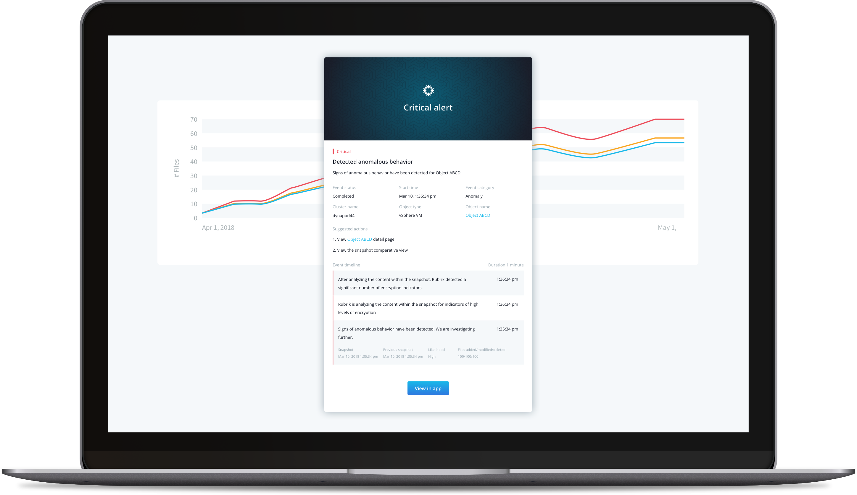
Stay Ahead of Threats with Machine Learning
Detect Anomalies
We apply behavioral-based detection on application metadata to send alerts on unusual change activity. By using machine learning, we can detect new strains of ransomware.
Notes:
First, let’s talk about detection.
Backup is unique in your IT environment because it touches so many of your production systems, across vendors, data centers, and clouds.
That means Rubrik is in a unique position to detect changes and anomalies in your environment. We also recognize that malware and other threats are constantly changing.
To that end, we use a KNN – K-nearest neighbor - classifier machine learning model on all your protected metadata from wherever the Rubrik software is deployed.
We look at properties like system change rates, abnormal system sizes, and even entropy changes in a specific file. We start off with a baseline model. Then we define what’s normal, so we can flag any unusual activity and send you alerts via our UI and by email.
This is behavioral-based ransomware detection, designed to be more effective today and in the future. If ransomware mutates, we can detect and alert you to it.
Best of all, our detection software has no impact on your production environment, since all the work is performed in Polaris, against historical data.

Slide 38

KNN – K-Nearest Neighbors Algorithm
Simplest classification algorithm and it is one of the most used learning algorithms
KNN is a non-parametric – this means that it does not make any assumptions on the underlying data distribution.
The model structure is determined from the data.
Lazy Algorithm - KNN should be one of the first choices for a classification study when there is little or no prior knowledge about the distribution data.
There is no explicit training phase or it is very minimal. This also means that the training phase is pretty fast

Slide 39



The Architecture Summary
1. Snapshot taken of VM and indexed.
2. Index “diff’ed” against previous snap.
3. “Diff” Index sent to Polaris for analysis.
Polaris

Slide 40
Our Anomaly Detection Model
Machine Learning Model learns baseline behavior
Detect anomalies and alert as they come in!
11 PM Mon
11 PM Tues
11 PM Wed
10 Files Added
20 Files Modified
4 Files Removed
8 Files Added
23 Files Modified
6 Files Removed
2032 Files Added
1321 Files Modified
2032 Files Removed
Notes:
Here is an example of detection
Our machine learning model proactively monitors file content change rates to flag any outliers and generate an alert.
For every snapshot,
Radar analyzes several file properties,
including file change rate, inconsistent content and file type, and entropy change of a file.
This filesystem behavior model is a custom-trained machine learning model developed uniquely for each customer over time.

Slide 41
What happens post anomaly detection?
Email alert sent to user.
Radar inspects snapshot for encryption.
Results uploaded to Polaris.
User informed of results (in Polaris UI).
Polaris

Slide 42
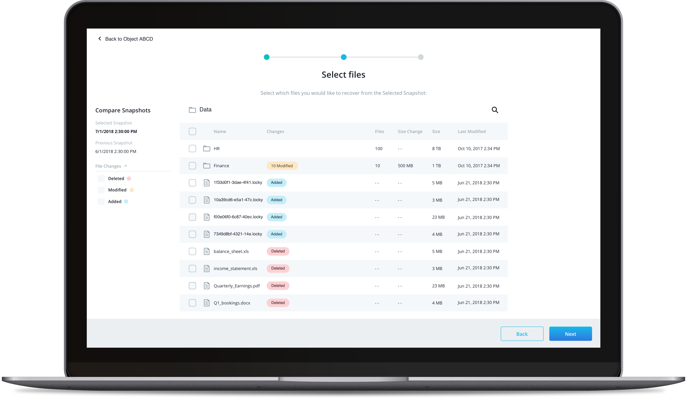
Prevent Data Loss with Intelligent Data Analysis
Analyze Threat Impact
Visualize how an attack impacted your entire system with a detailed view of file content changes at the time of the event. Drill-down to investigate what changed at the file-level.
Notes:
After detection comes analysis – understanding the scope of the attack and what surfaces have been impacted.
Once an anomaly is detected, we begin investigating what happened. We start comparing the post-attack snapshot with the snapshot immediately before to see what was added, deleted, or modified.
Our UI exposes our analysis in an easy-to-understand and intuitive manner. You can see in real-time exactly what is the scope of the damage, what you need to recover, and where they are located.
We even show you what was changed at the file-level. We’ve heard from our customers that this level of granularity is incredibly helpful because it minimizes the risk of data loss from a mass restore. Admins can see which subset of your production data has been hit by ransomware and roll back selectively, minimizing the chance that a mass restore would cause teams to lose all their recent work product.
We use Analysis to understand the scope of the attack.
Once an anomaly is detected, Radar begins investigate what happened. It starts comparing the post-attack snapshot with the snapshot immediately before to see what was added, deleted, or modified.
The UI exposes our analysis in an easy-to-understand and intuitive manner. You can see in real-time exactly what is the scope of the damage, what you need to recover, and where they are located what was changed at the file-level.
Admins can see which subset of production data has been hit by ransomware and roll back selectively, minimizing the chance of a mass restore which could cause data loss of all their recent work.
The #1 reason we hear from customers about recovering from ransomware is identifying the infected files and applications. That’s because most solutions today have very limited awareness into which snapshots and files have been compromised.
Radar reduces the time it takes to determine what needs to be recovered and continuously analyzing the entire file system to identify all file content changes over time.
In the case an anomaly is detected, like ransomware, it automatically begins analyzing the changes at the time of the event. Now, you can understand in real-time exactly what applications and files were affected and where they are located.
In the UI we tag each folder with the number of files added, deleted, or modified and drill-down to analyze what has changed at the file level. This granular analysis is critically important to minimize data loss.
And Now, you don’t have to perform full system restores and can just recover exactly the applications and files that have been infected.

Slide 43
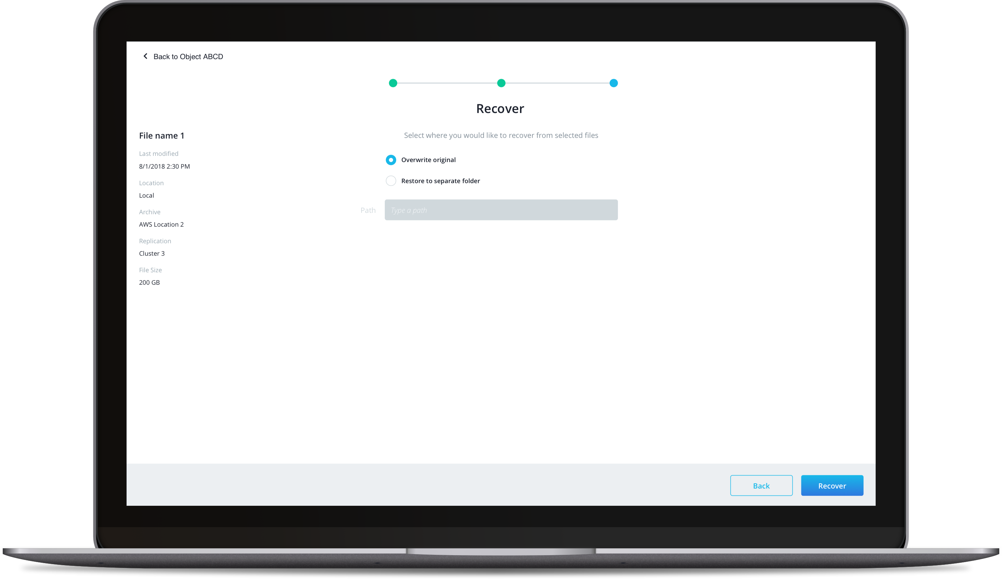
Minimize Downtime with Fast Restores
Accelerate Recovery
Simply select all impacted resources, specify the desired location, and restore the most recent clean versions with just a few clicks. Rubrik automates the rest of the restore process.
Notes:
Now for recovery: it’s absolutely critical to your resiliency and defense to restore quickly and painlessly. Rubrik was built to make recovering data extremely fast and simple from day one.
Radar builds on that by providing an app designed specifically to make ransomware recovery even faster and simpler.
Whether you want to recover millions of VMs or a single file, the restore is as easy as a few clicks. You simply select what you want to restore and where you want to restore to. All the heavy lifting is done by the Rubrik software. You can even track the progress via our UI.
We put all the clean versions of your data back into the right spot, so you can get back to business like nothing ever happened.
Radar can help organizations recover faster from any kind of security event.
Beyond ransomware, this may include an insider threat, where a disgruntled employee tries to delete production data, or even human error like accidental deletion.
It doesn’t matter if you want to recover from millions of VMs or a single file you just select what you want to restore and where you want to restore to. All the heavy lifting is done by Radar. You can even track the progress in the UI.
And since all data is captured in an immutable format, you never have to worry about ransomware accessing and encrypting your backups.

Slide 44
Benefits
Features | Before Radar | After Radar
Immutable backups | ✓ | ✓
Fast recovery | ✓ | ✓
Machine learning-driven detection |  | ✓
Data analysis on threat behavior and impact |  | ✓
Granular recovery with just a few clicks |  | ✓
Notes:
Radar is not competing with real-time security vendors.
Radar is a unique, in that is compliments current security protection with early detection and mitigation with fast recovery and does this with increased intelligence to stay ahead of ransomware mutations and evolutions.
TCO Savings Example – Moore Van Allen
They have a 2,000 VM environment with 100GB average VMs, so they have about 200 FETB (Front End TB) to protect.
We took their $/downtime hour (revenue divided by hours in the year) metric,
assumed they have 1 ransomware attack per year, which them 48 hours to recover from –
their cost of downtime is over $1 million dollars.
This is a 70% TCO savings
This can translate into $5K lost per FETB.
( If you assume they are 25% likely to get hit by ransomware attack, then we can charge them up to $382 FETB / year. If you take a 6410, that’s equivalent to about $57K per year. )

Slide 45
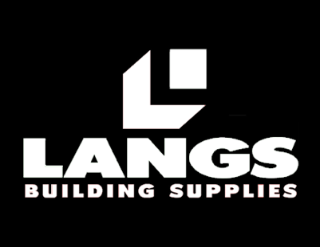
What our customers are saying
“When we were hit by ransomware a few years ago, we leveraged Rubrik’s fast recovery and APIs to recover in under an hour with zero data loss. Today, ransomware is much more sophisticated than it was a few years ago. With Radar, we could leverage its data intelligence to alert us on suspicious behavior and better understand what was impacted at a granular level.”
– Matthew Day, CIO
Notes:
Langs Buildings Supplies, a construction supplies manufacturer in Australia, used Rubrik to recover from ransomware in under an hour, with no data loss, more than two years ago. We’re proud that we were able to help them get back on their feet so quickly.
Ransomware has only become more sophisticated since then. And the Langs CIO is excited about Radar because it would mean another boost to their ability to detect ransomware, coupled with even faster, more granular recovery.
It’s always exciting when our products can help a great, highly resilient IT team become even better.

Slide 46
Results with Rubrik
Scottish Government
(Public)
33% TCO savings
60% management time savings (FTE savings)
6x faster backup performance
79% data reduction
Near-zero RTOs
High 5 Games
(Media & Entertainment
Significant management time savings (FTE savings)
Faster backup performance
Easy cloud mobility with Google Cloud Platform
Sugar Creek
(Manufacturing)
90% management time savings (FTE savings)
Easy Cloud mobility to AWS S3
Streamlined compliance for audits
Notes:
Scottish Government
THE CHALLENGE • Fragmented management with a multi-point legacy architecture • Inability to scale with data growth • Difficulty ensuring all backups were secure and encrypted
THE SOLUTION • Comprehensive security with end-to-end encryption and audit trails • Instant recovery • Seamless integration with AWS S3 for cloud mobility • RESTful APIs to automate workflows at scale
5 Games
THE CHALLENGE • Legacy cloud infrastructure unable to scale • Ensuring all backups are secure and encrypted to meet regulatory requirements • Complex and inefficient backup process
THE SOLUTION • Cloud archival with Google Cloud Platform • End-to-end encryption and fast recovery for accelerated GDPR compliance • Automated policy engine to easily manage SLAs
Sugar Creek
THE CHALLENGE • Complex, time-consuming legacy backup • Lack of automation • Inability to granularly define SLA policies
THE SOLUTION • One platform for automated backup, recovery, public cloud archival, and test/dev • Integrates seamlessly with VMware vSAN • Enabled easy integration to public cloud

Slide 47

Call to action
Come see us at the Expo Hall at booth #1500
Find out more about Rubrik at https://www.rubrik.com/
Get more technical information at https://www.rubrik.com/resources/and https://www.rubrik.com/blog/

Slide 48
Please evaluate this session Your feedback is important to us!
Please evaluate this session through MyEvaluations on the mobile app or website.
Download the app: https://aka.ms/ignite.mobileApp
Go to the website: https://myignite.techcommunity.microsoft.com/evaluations

